Slide 1
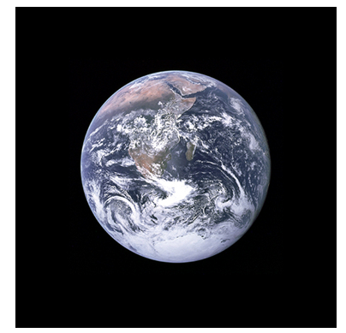
Does Science Support Net Zero Policies?
Muskoka Huntsville Talk
May 28, 2024
W. A. van Wijngaarden
Physics Dept., York University
Toronto, Canada
www.wvanwijngaarden.info.yorku.ca

Slide 2
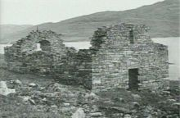
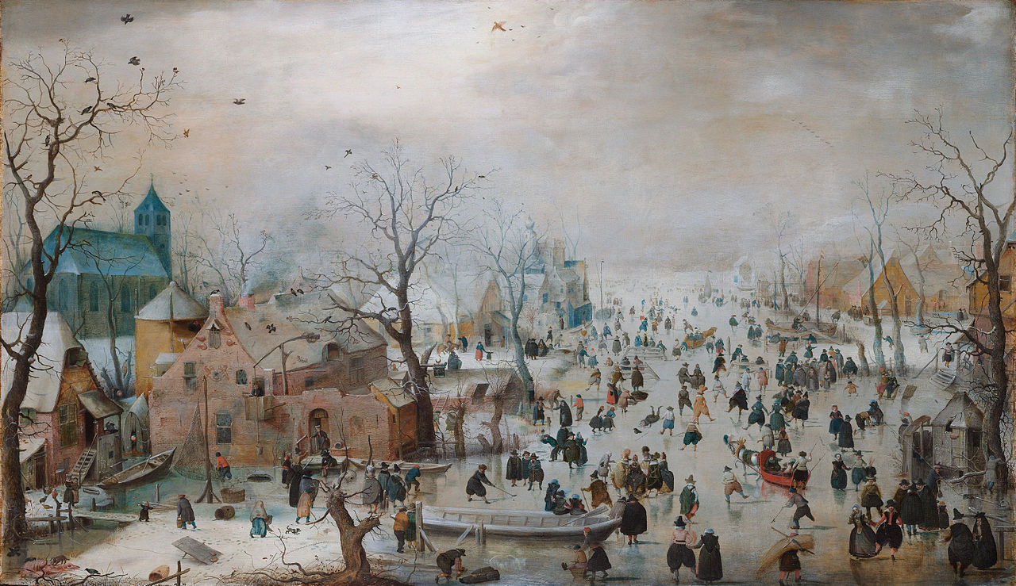
Is Climate constant?
Medieval Warm Period b) Little Ice Age 1400-1800
900-1400
Hvalsey Catholic Church Winter Dutch Landscape
Southern Greenland H. Avercamp 1608

Slide 3
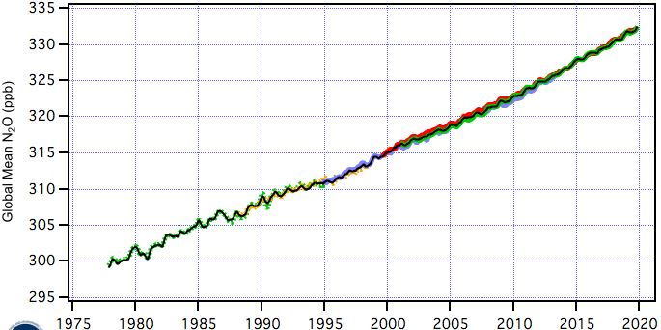
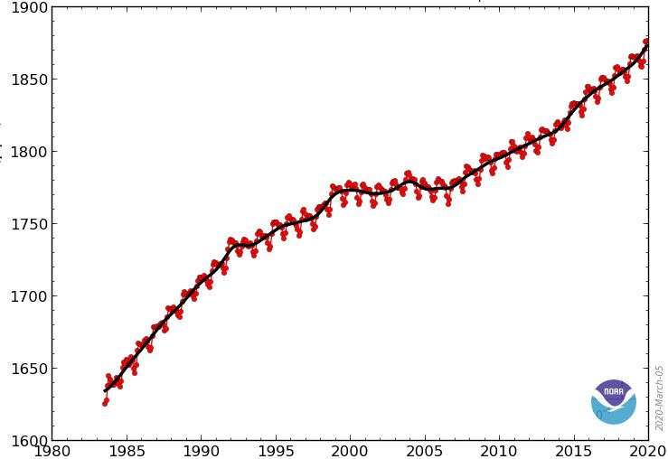
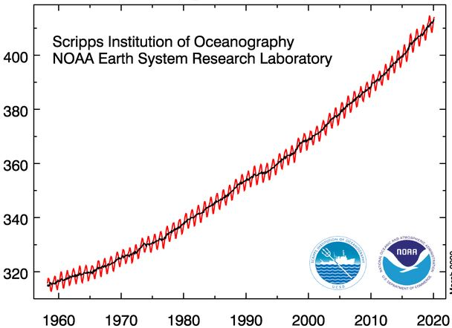
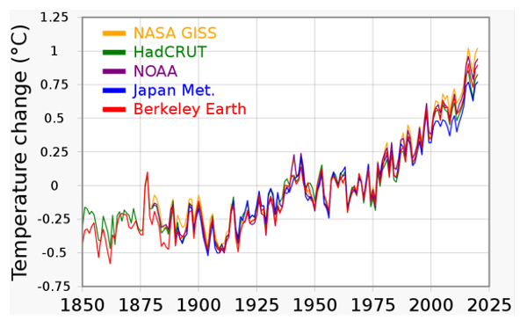
Increase in Greenhouse Gases
www.esrl.noaa.gov and scrippso2.ucsd.edu
330
320
310
300
1.9
1.8
1.7
1.6
CO₂ (ppm)
N₂O (ppb)
CH₄ (ppm)
400
380
360
340
320
Concentration
1980 1990 2000 2010 2020
1980 1990 2000 2010 2020
1960 1970 1980 1990 2000 2010 2020
Global Climate Models failed to predict 2000 – 2016 hiatus
There is more going on than just CO₂!

Slide 4
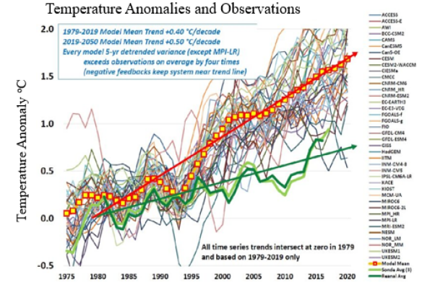
Intergovernmental Panel Climate Change
J. R. Christy, Testing Climate Claims (2021)
Model Average
Observations

Slide 5
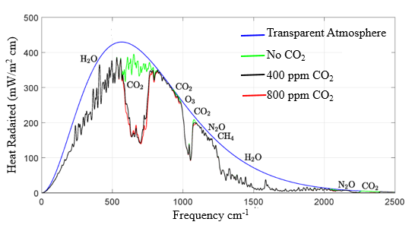
Heat Emission to Outer Space
WvW & W. Happer, Atmos. & Oceanic Phys. arXiv: 2006.03098 (2020)

Slide 6
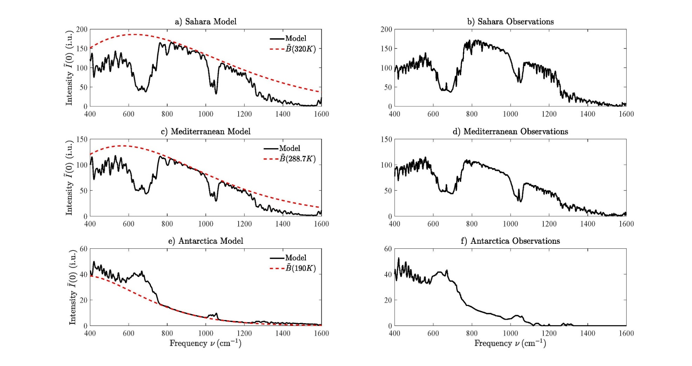

Model Comparison to Satellite Observations
WvW & W. Happer, Atmos. & Oceanic Phys. arXiv: 2006.03098 (2020)
a) Sahara Model b) Sahara Observations
Model Observations
Intensity
c) Mediterranean Model d) Mediterranean Observations
Intensity
e) Antarctica Model f) Antarctica Observations
Intensity

Slide 7
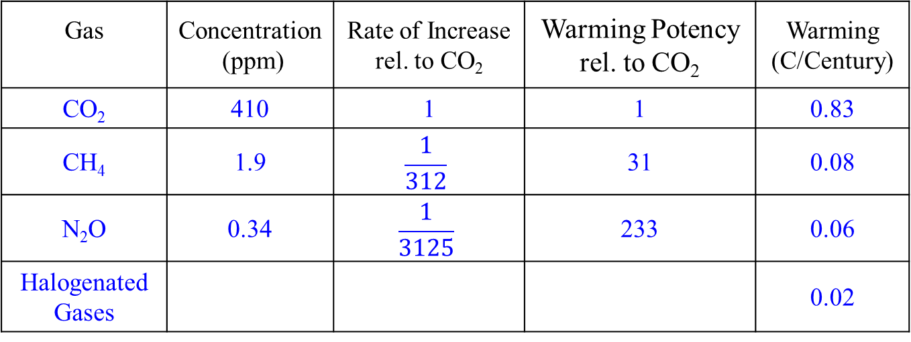
Greenhouse Gas Contribution to 21st Century Warming
WvW & WH, Atmos. & Oceanic Phys, arXiv: 4971146 (2023)
Assume same warming in 21st century as in 20th century ∼ 1 K/century & all warming is due to increase in greenhouse gases
Gas | Concentration (ppm) | Rate of Increase rel. to CO₂ | Warming Potency rel. to CO₂ | Warming (C/Century)
CO₂ | 410 | 1 | 1 | 0.83
CH₄ | 1.9 | $$\frac{1}{312}$$ | 31 | 0.08
N₂O | 0.34 | $$\frac{1}{3125}$$ | 233 | 0.06
Halogenated Gases |  |  |  | 0.02

Slide 8
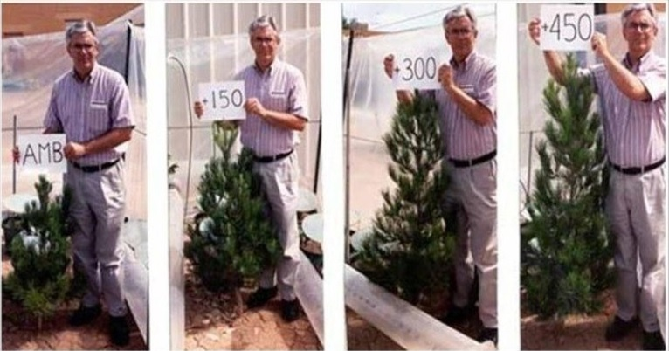
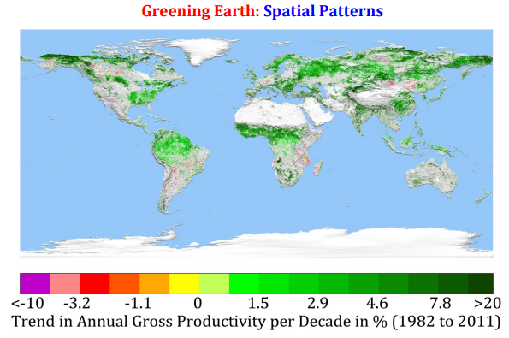
Vegetative Response
Increased growth may reduce rate of CO₂ increase
(C. Idso, Energy & Env. 12,
No. 4, 287 (2001)
More CO₂
⇒ smaller stomata reducing
water loss
easier for plants to grow in
arid regions
(Z. Zhu et al, Nature Climate
Change 7, 791 (2016)

Slide 9
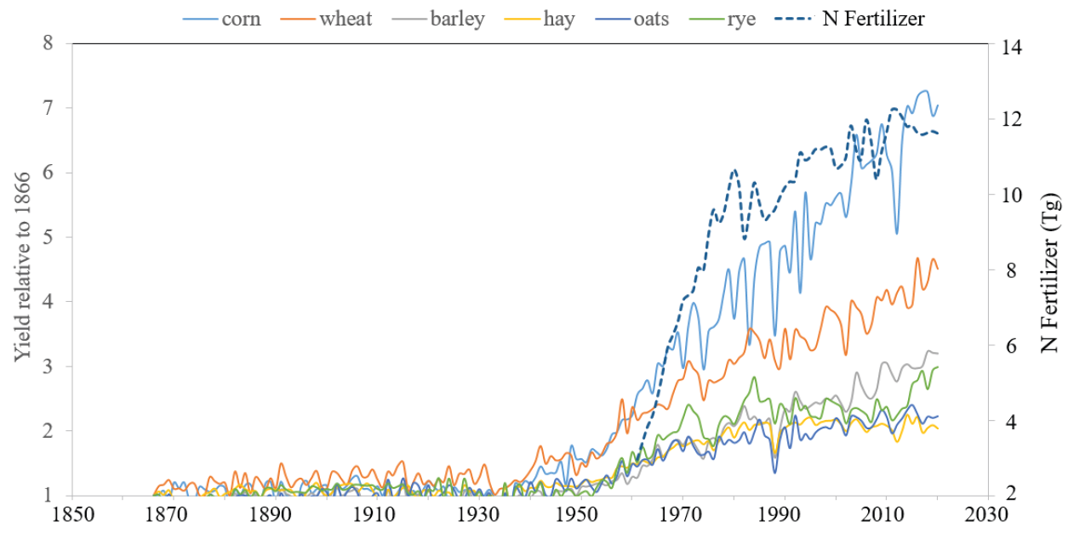
Effect of N Fertilizer on Crop Yield
US Crop Yields www.nass.usda.gov/Publications/Todays_Reports/croptr19
Outlawing fertilizer use to stop atmospheric N₂O increase threatens world food supply and reduces temperature rise by < 0.1 C per century!

Slide 10
Arctic Sea Ice
National Snow & Ice Data Center nsidc.org
Arctic ice decreased during 1979-2024 but Sept. ice stable for 2007 – 2023
Expedition sailed as far north as 81º 29’ in ice-free water. Arctic is not recognizable with region of previous 50 years. Glaciers have been replaced by mounds of earth & stones. Great shoals of fish have disappeared & seal population has diminished…..
G. N. Ifft, “The Changing Arctic”, Monthly Weather Review, 589.

Slide 11
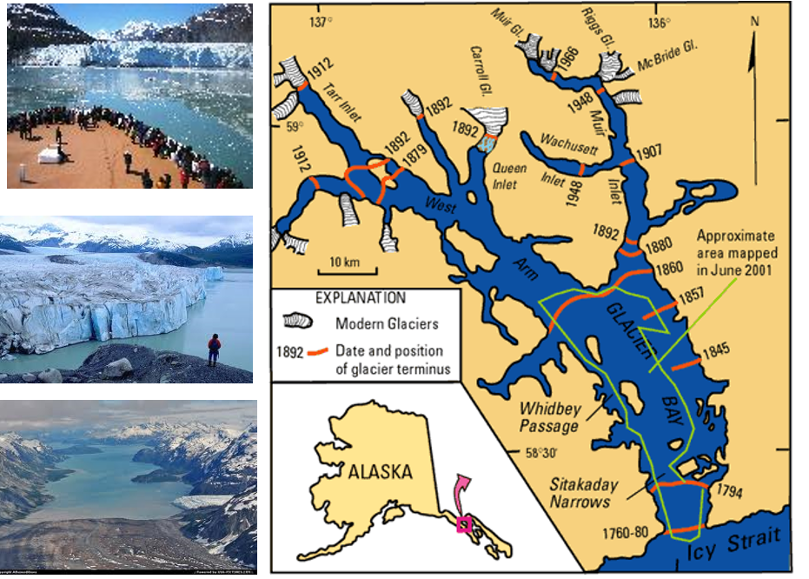
Glacier Bay, Alaska
100 km

Slide 12
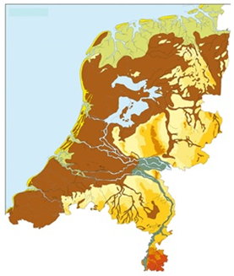
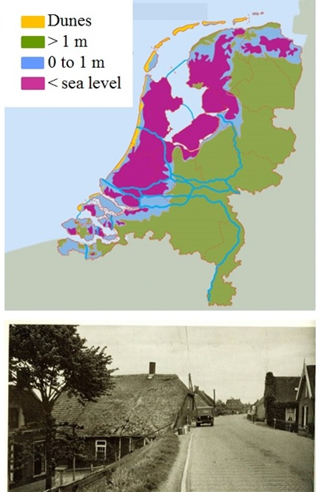
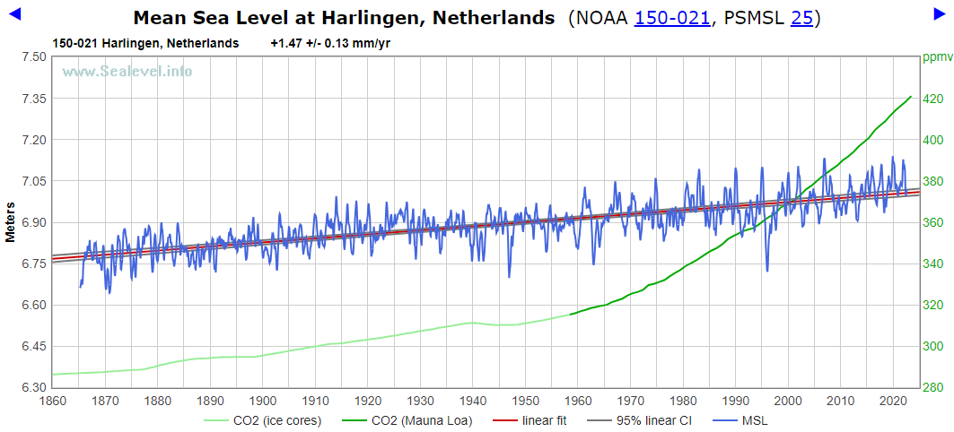
Sea Level Rise & the Netherlands
a) 500 BC
b) TODAY
Harlingen, Netherlands, NOAA 150-021, psmsl.org, courtesy D. Burton
Slope = +1.47 ± 0.13 mm/yr
Mean Sea Level (meters)
CO₂ Concentration (ppm)

Slide 13
Precipitation Change relative to 1961-90
WvW & A. Syed, J. Hydrology 531, 1020 (2016)
Red = moving 5 year average
United Kingdom b) India/Pakistan
c) Lower 48 US d) California

Slide 14
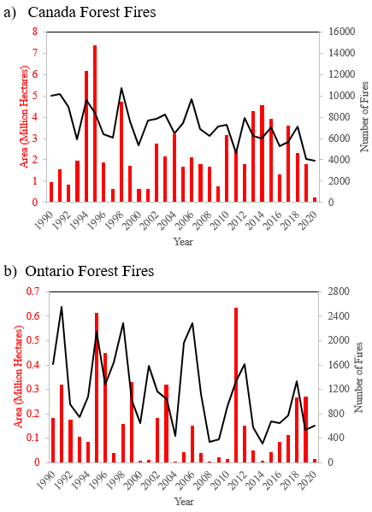
Canadian Wildfires National Forestry Database, www.nfdp.ccfm.org/data/graphs

Slide 15
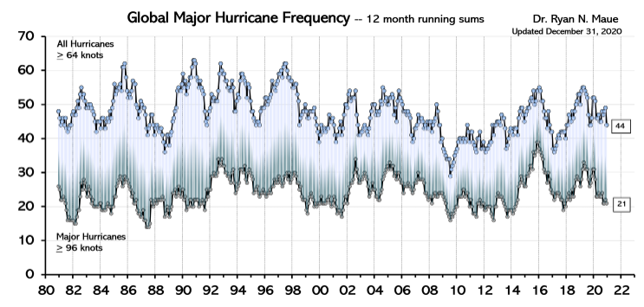
Do we have more storms – hurricanes?
R. Maue, Geophys. Res. Lett. 38, L14803 (2011) & updated (2020)
All Hurricanes
Major Hurricanes

Slide 16
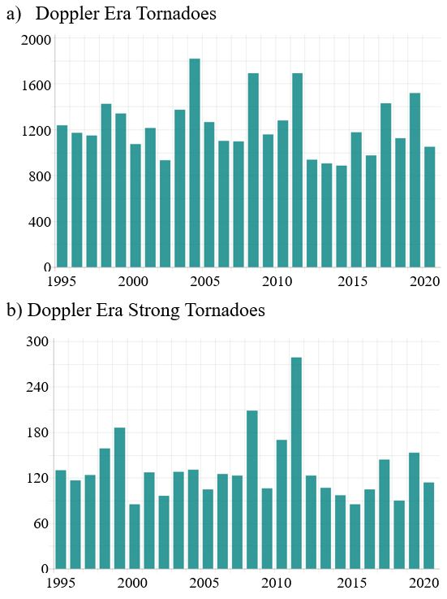
Frequency of U.S. Tornadoes www.ncdc.noaa.gov/climate-information/extreme-events/us-tornado-climatology/trends

Slide 17
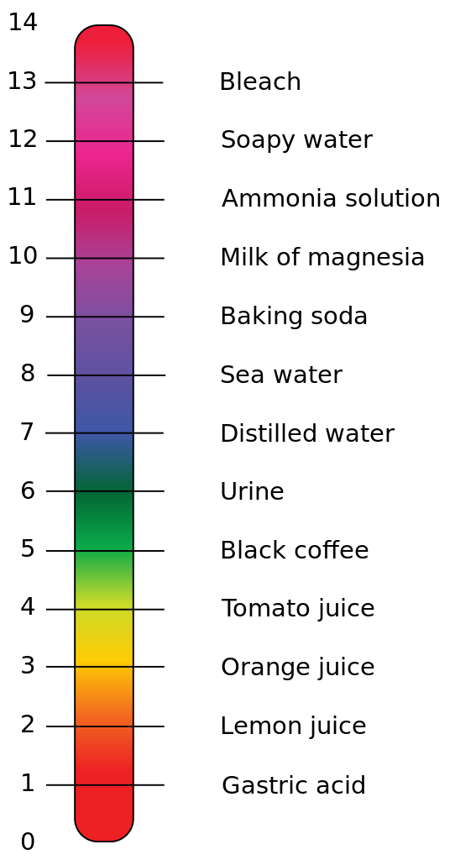
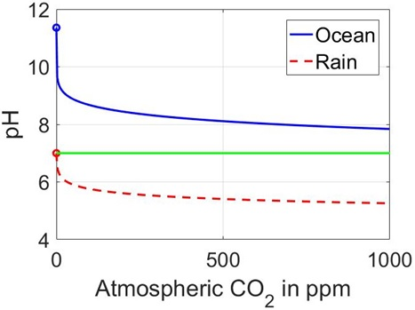
Ocean Acidification
R. Cohen & W. Happer, Fundamentals of Ocean pH (2015)
Some CO₂ combines with water to generate carbonic acid.
CO₂ + H₂O ↔ H₂CO₃
pH Scale
Bleach
Ammonia
Baking Soda
Distilled H₂O
Coffee
Orange Juice
Stomach Acid
pH Change due to 400 → 800 ppm CO₂ = 0.27

Slide 18
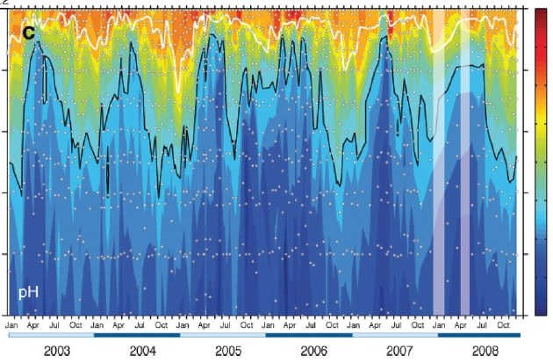
Santa Monica Bay pH Measurements
J. Leinweber & N. Gruber, J. Geophys. Res. Oceans 118, 3622 (2013)
0
50
100
150
200
250
8.3
8.2
8.1
8.0
7.9
7.8
7.7
7.6
7.5
Depth (m)
pH

Slide 19


Conclusions
Extrapolating observed 20th century warming of 1 C to 21st century gives:
Evidence doesn’t support hysteria about: droughts/floods, polar ice/glacier retreat, sea level rise, ocean acidification, forest fires etc.
More Info: WvW, Impact of Greenhouse Gas on Ontario’s Climate, Atmos. & Oceanic Phys arXiv: 2305.05500 (2023)
Gas | Global Warming C / Century | Canada Emissions Fraction (%) | Caused Warming C/Century
CO₂ | 0.83 | 1.5 | 0.012
CH₄ | 0.08 | 1.1 | 0.0009
N₂O | 0.06 | 1.4 | 0.0008
Total Warming | 1.0 |  | 0.014
Outlawing fertilizers/reducing herds negligibly affects climate & endangers global food supply
Beware of unintended consequences. eg. Replacing food produced efficiently by Canadian farmers with that grown in Brazil will destroy Amazonian rainforest
World not close to climate crisis in < 10 or even 100 years

